Slide 1

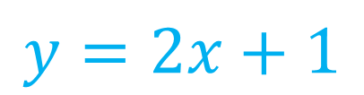


Algebra Interactive Notebook
$$3ab$$
$$\frac{5xy}{6}$$
Name :
Class :
Term 1 Semester 1
$$2x+3y$$
$$y=2x+1$$

Slide 2
Contents
Glossary
Page
Date
Description
2
3

Slide 3
Tasks
24
7
30
Essential Question
Questions
Notes
Summary
4
7

Slide 4
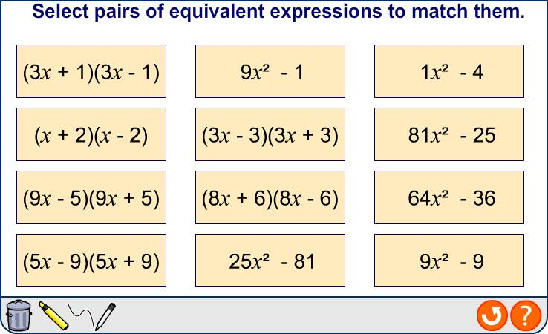

The difference between two squares
Notes:
4
Teacher notes
Select a bracketed expression and ask a volunteer to find its corresponding expansion.

Slide 5
Squaring expressions
Expand and simplify: (2 – 3a)²
(2 – 3a)² = (2 – 3a)(2 – 3a)
=
4
– 6a
– 6a
+ 9a²
= 4 – 12a + 9a²
Notes:
5

Slide 6
Squaring expressions
It can be seen that there is a pattern relating a squared expression and its form once expanded and simplified.
(a + b)² = a² + 2ab + b²
The first term squared…
…plus 2 × the product of the two terms…
…plus the second term squared.
For example,
(3m + 2n)² = 9m² + 12mn + 4n²
Notes:
6

Slide 7
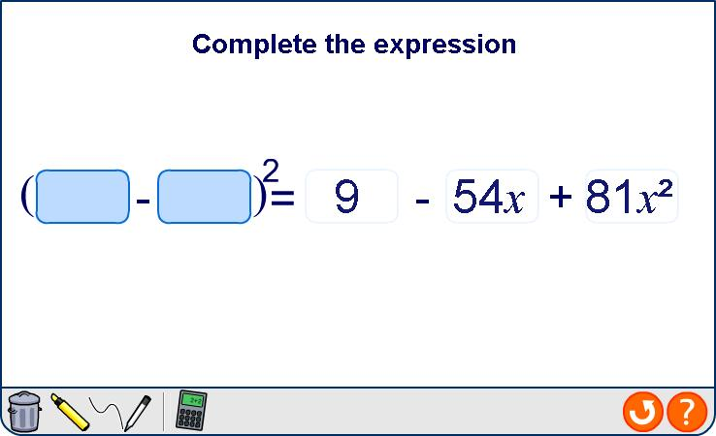
Squaring expressions
Notes:
7
Teacher notes
Any of the terms in the expansion can be hidden or revealed to practice squaring expressions.

